Slide 1
Gain correction with the E/p ratio Muons Meeting Sam Grant 17th May 2019

Slide 2
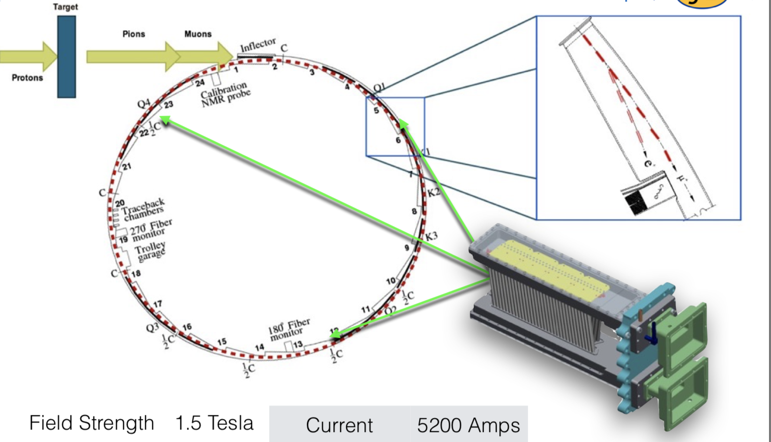
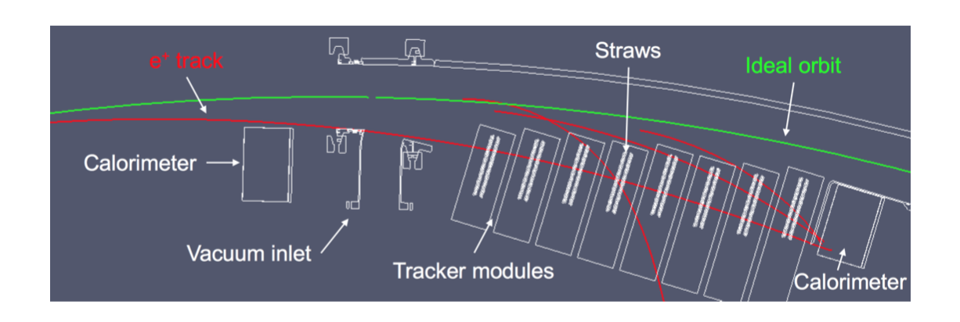
Quick note on the g-2 detectors
24 calorimeters, 54 lead fluoride scintillating crystals in each
I am interested in calos 13 and number 19, which have 8 straw tracking detectors in front (so we can match tracks)

Slide 3
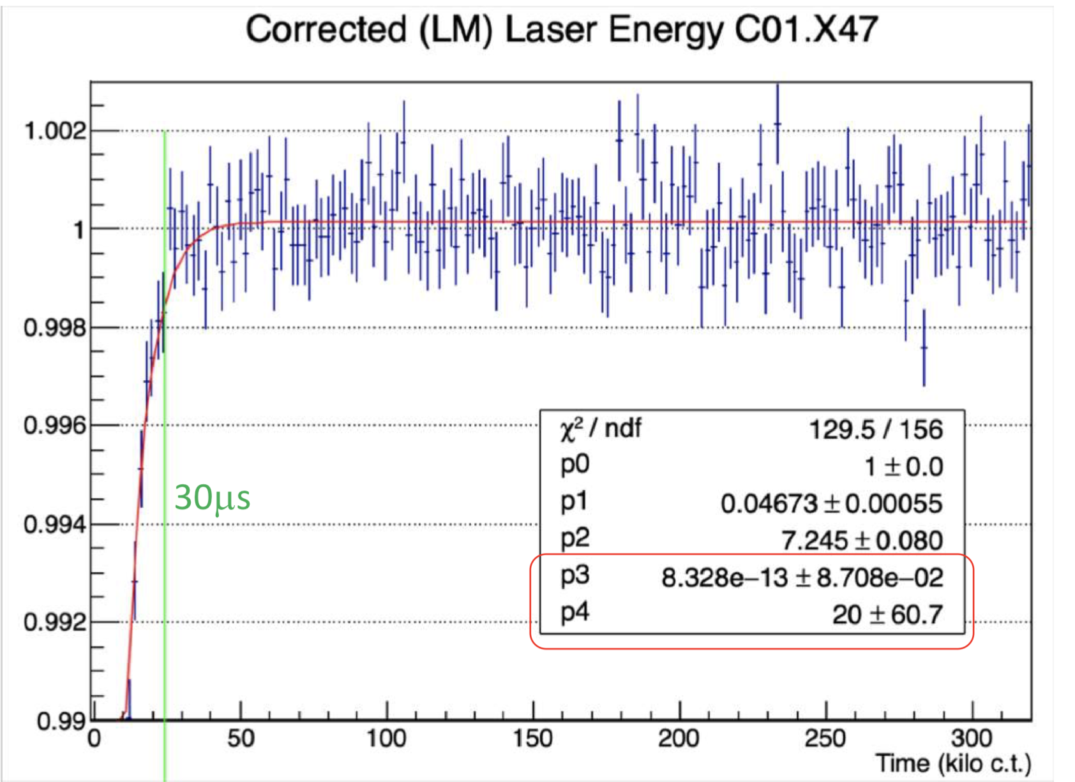
Gain sag
Just after injection there is a slight drop and subsequent recovery of gain, which must then be corrected!
There is a laser system that We can double check the results from the laser, and hence the gain corrections, by using tracker-calo matched tracks.
Credit: ω_{a} Europa
https://gm2-docdb.fnal.gov/cgi-bin/private/ShowDocument?docid=17009

Slide 4
E/p ratio
Tracker-calo matched tracks provide a different way to measure gain.
The trackers measure the track curvature to get momentum, p, which is not affected by the flash
The calorimeter give the cluster energy, E, of the same track
Particles are relativistic, so E=p
E/p is therefore equivalent to gain

Slide 5
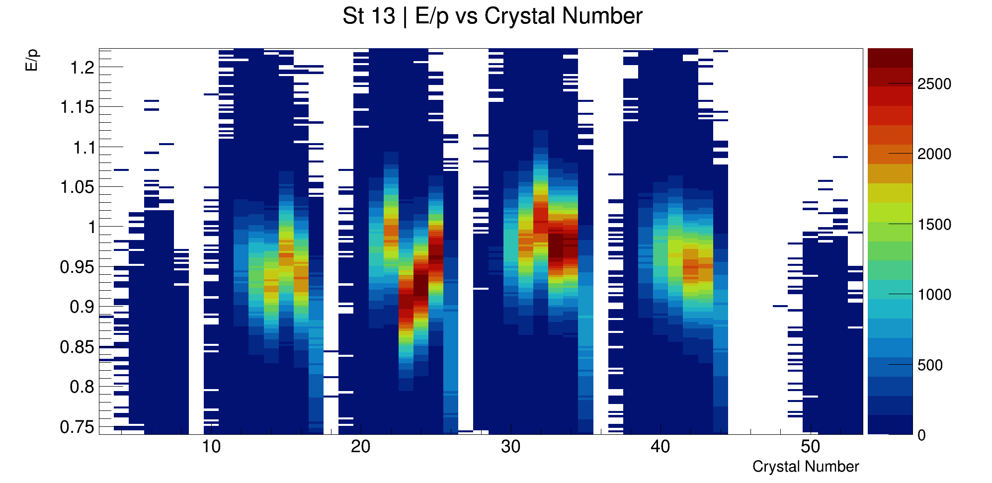
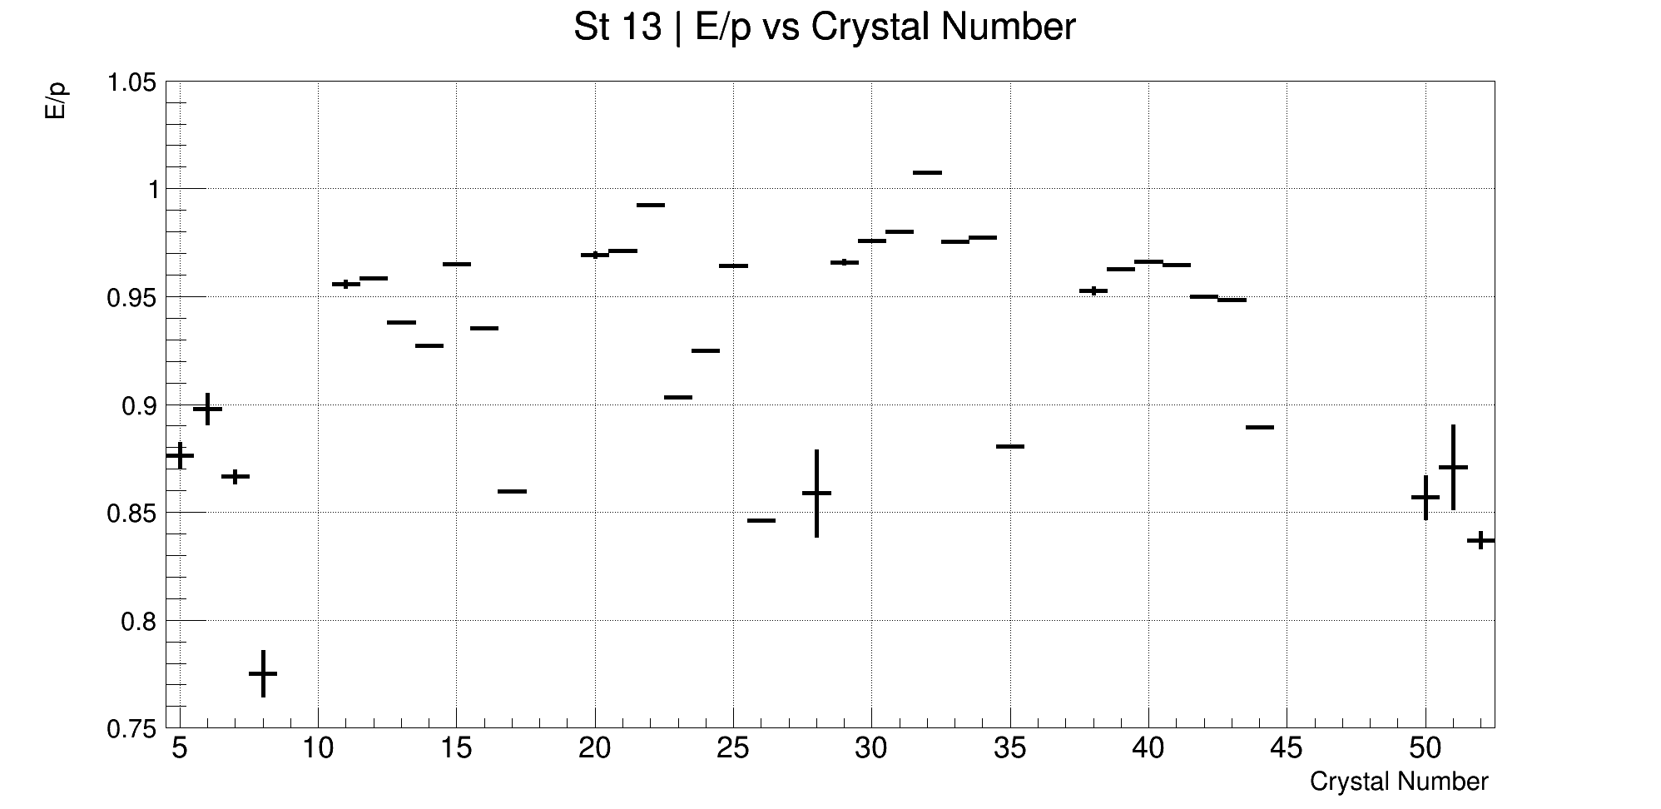
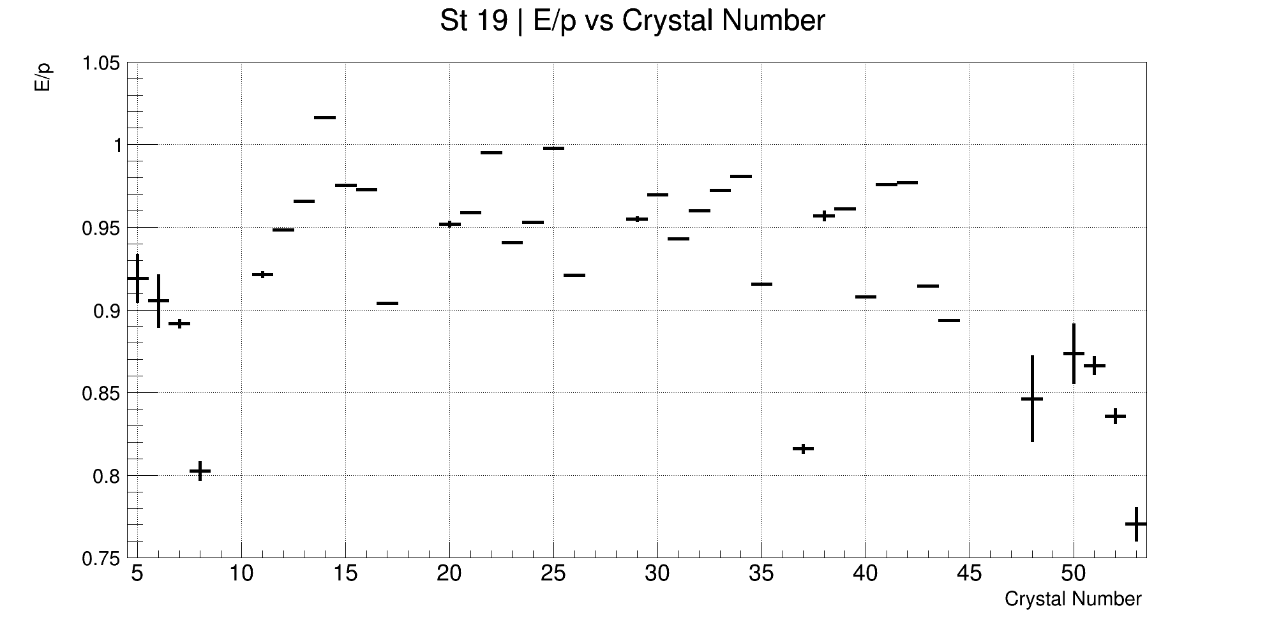
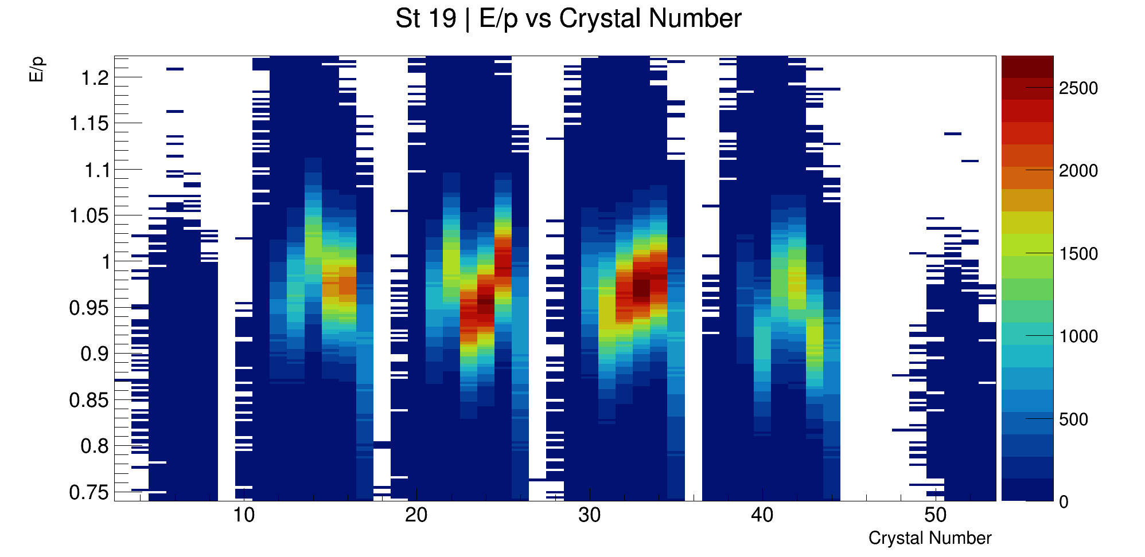
First Step: Normalisation per crystal
Different crystals have different mean values of E/p, to consider more than one crystal at a time this must be normalised

Slide 6
Gauss fits – E/p means per crystal
Calo 13
Calo 19
Xtal 0
Xtal 9
Xtal 45

Slide 7
Breaker Boards
Two different supply boards (breaker boards) per calo. Different electronics mean different recovery times for the crystals connected to these boards
45 | 46 | 47 | 48 | 49 | 50 | 51 | 52 | 53
36 | 37 | 38 | 39 | 40 | 41 | 42 | 43 | 44
27 | 28 | 29 | 30 | 31 | 32 | 33 | 34 | 35
18 | 19 | 20 | 21 | 22 | 23 | 24 | 25 | 26
9 | 10 | 11 | 12 | 13 | 14 | 15 | 16 | 17
0 | 1 | 2 | 3 | 4 | 5 | 6 | 7 | 8
Orange crystals represent the crystals attached to the board with a shorter recovery time

Slide 8
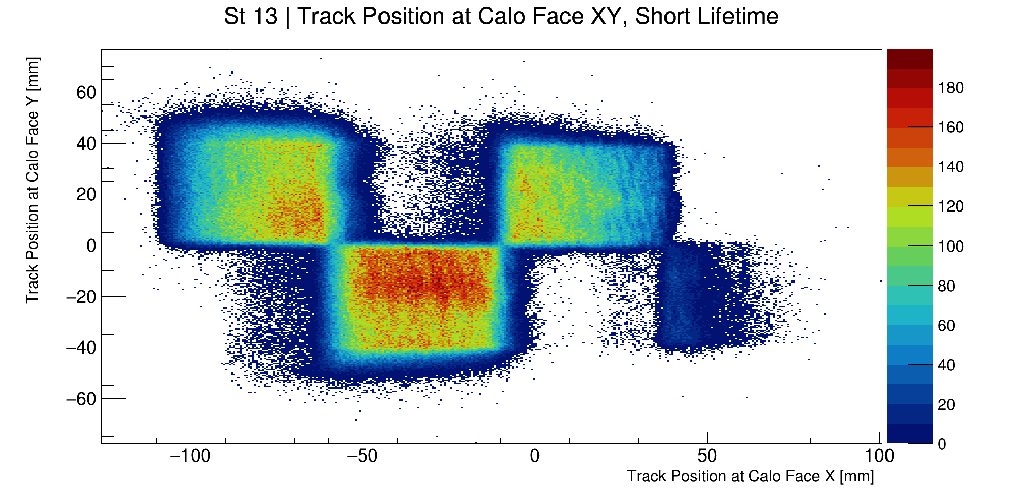
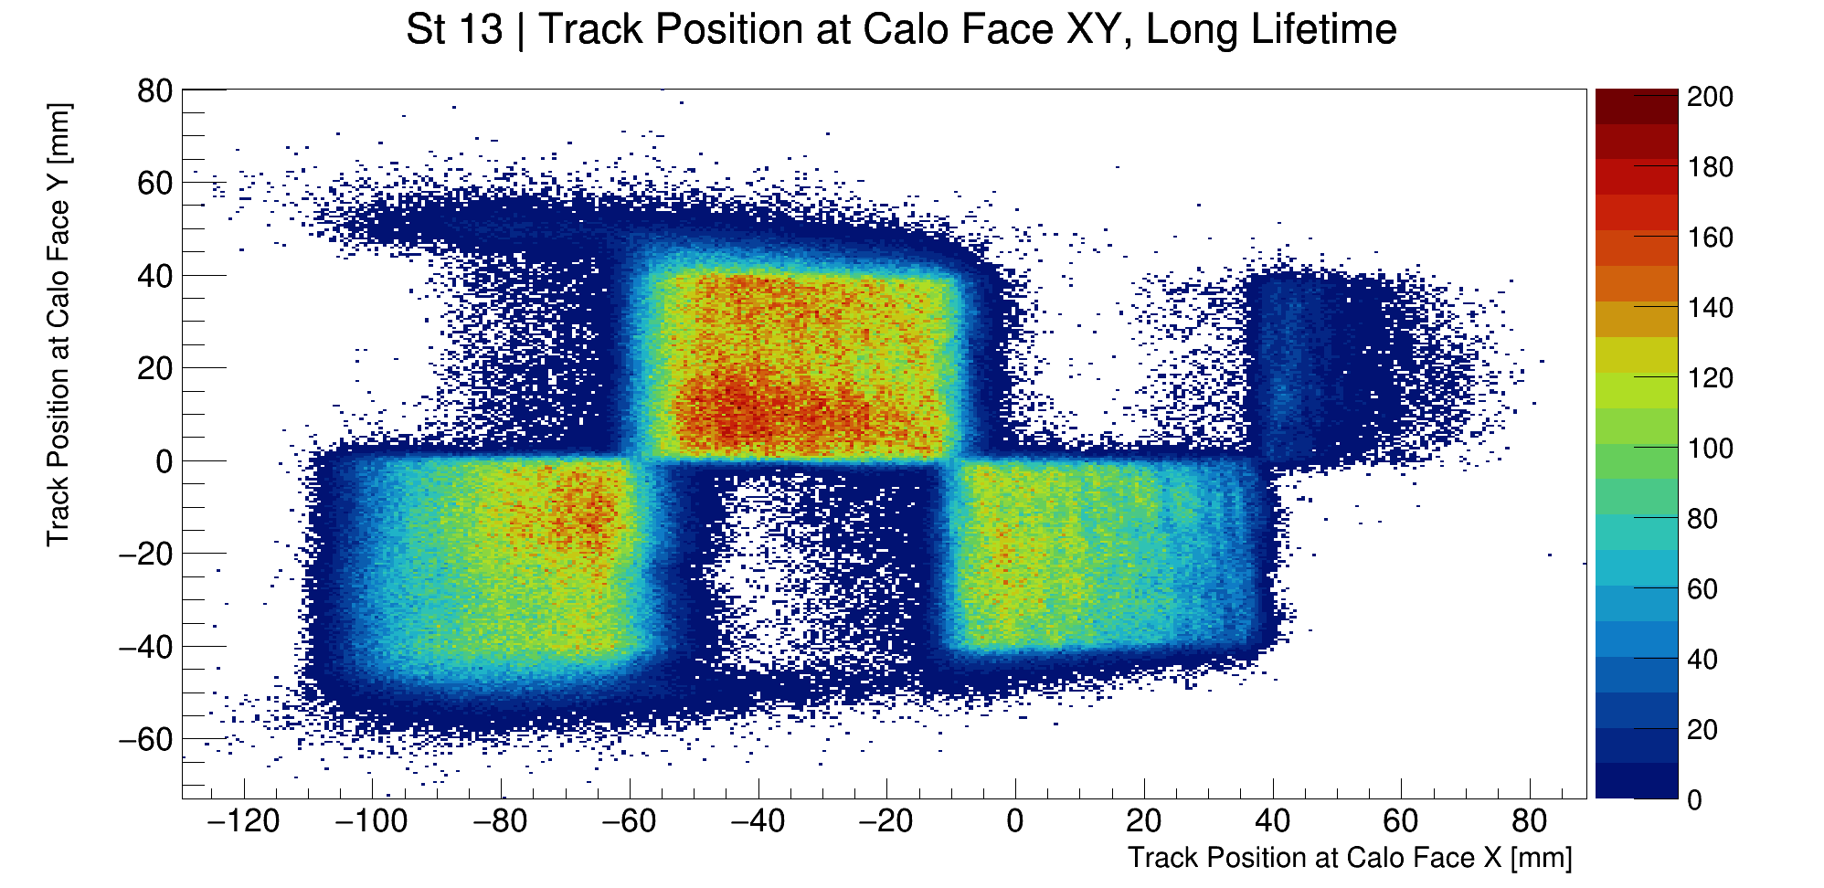
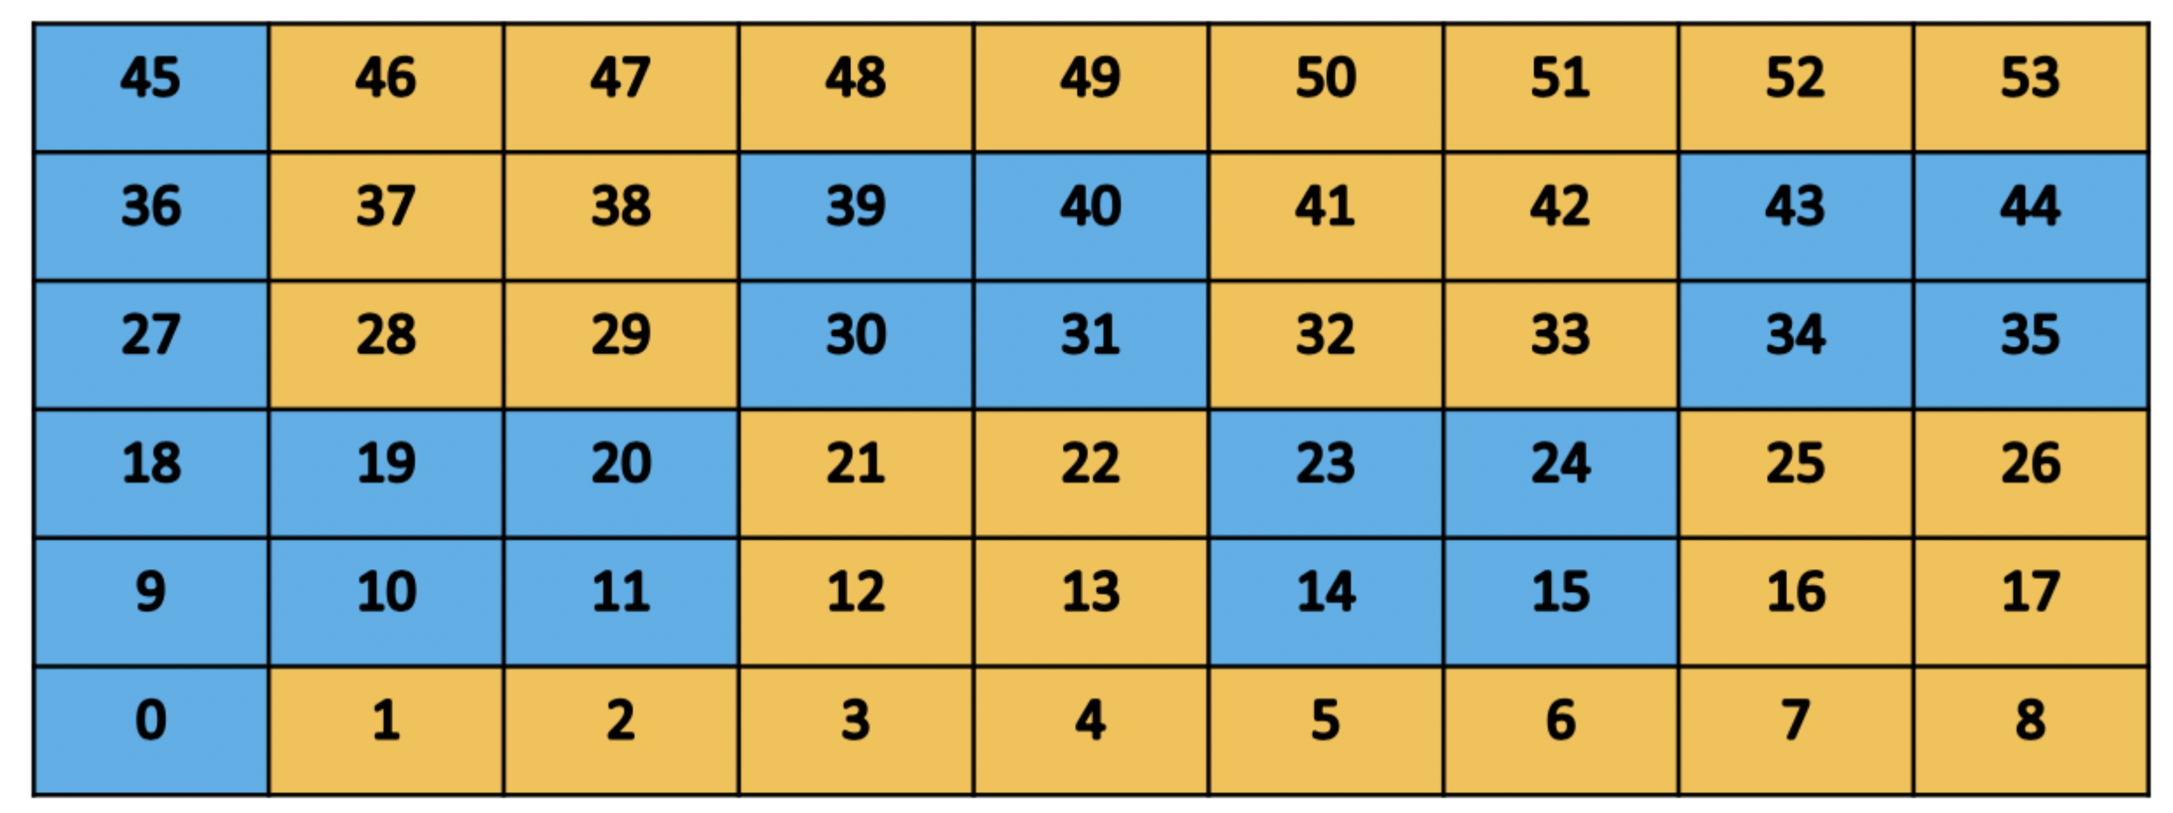
Breaker Boards
”Short lifetime”
”Long lifetime”

Slide 9
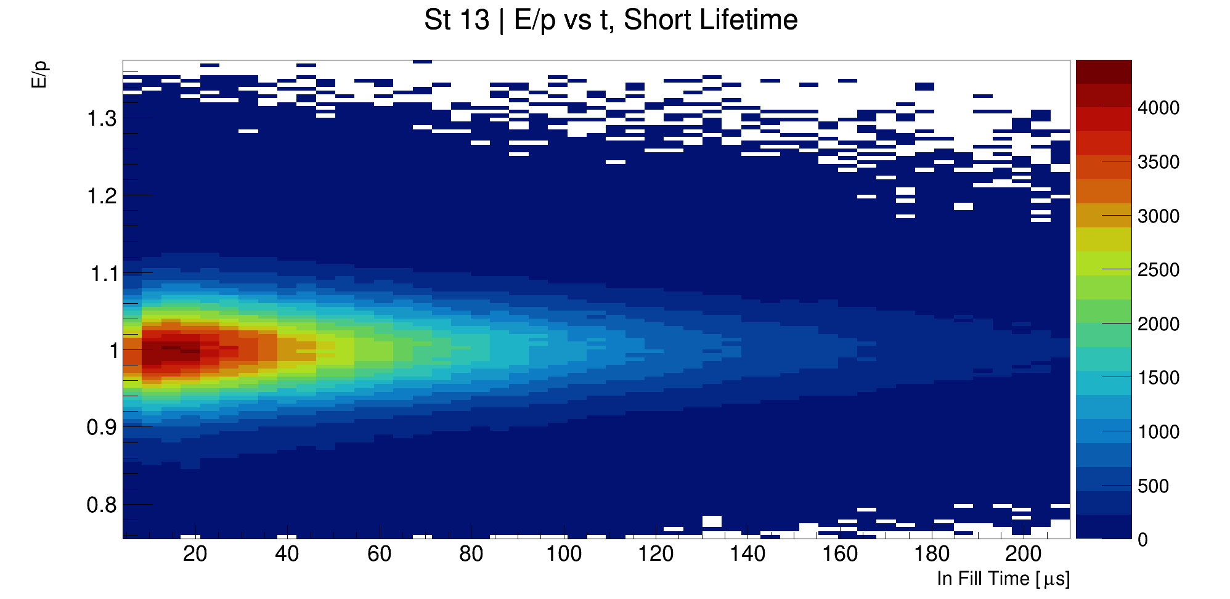
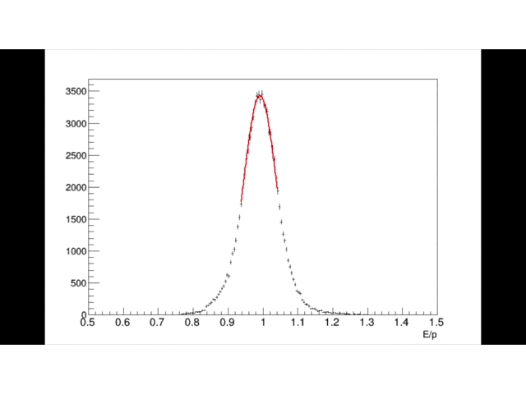
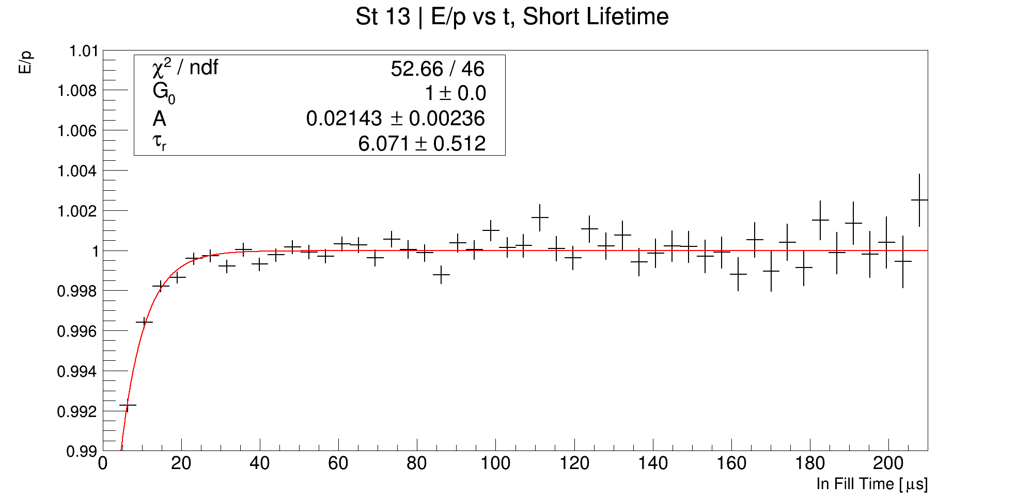
Draw normalised 2D plots
Slice vertically and fit the Y projections
Separate boards and draw gaussian means and fit exponential

Slide 10
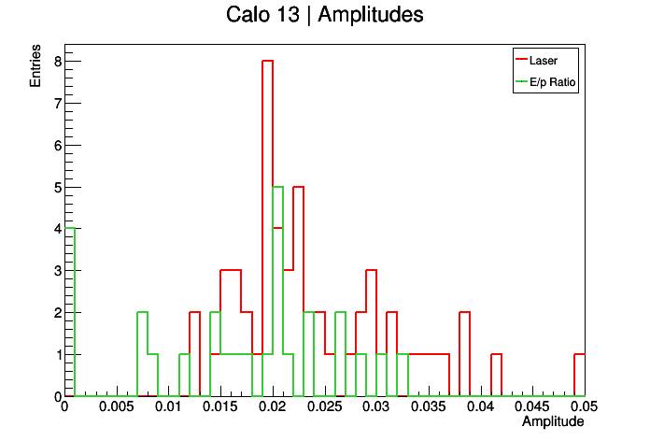
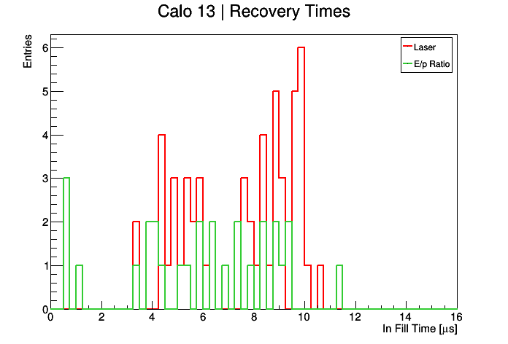
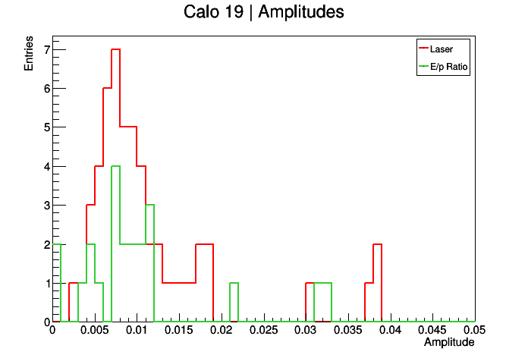
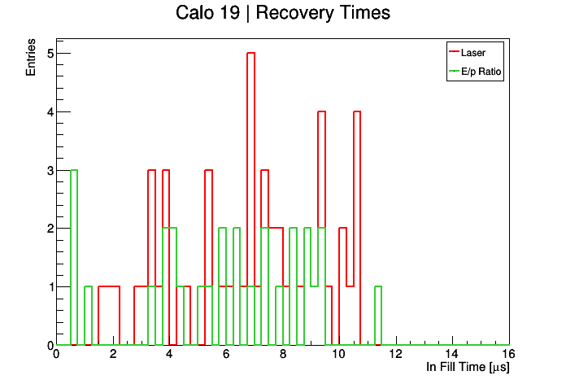
Next step: do this crystal by crystal and compared with laser results

Slide 11
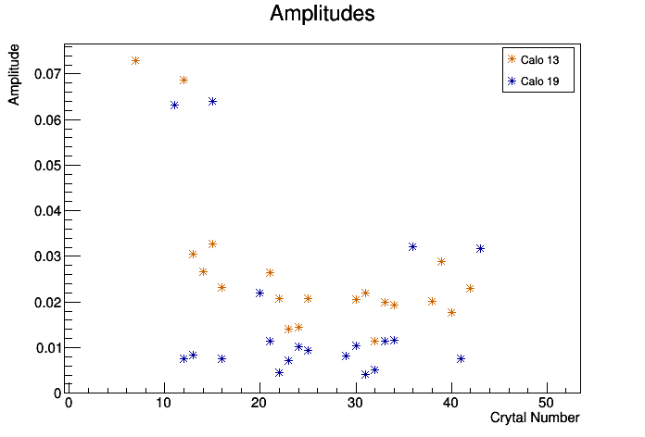
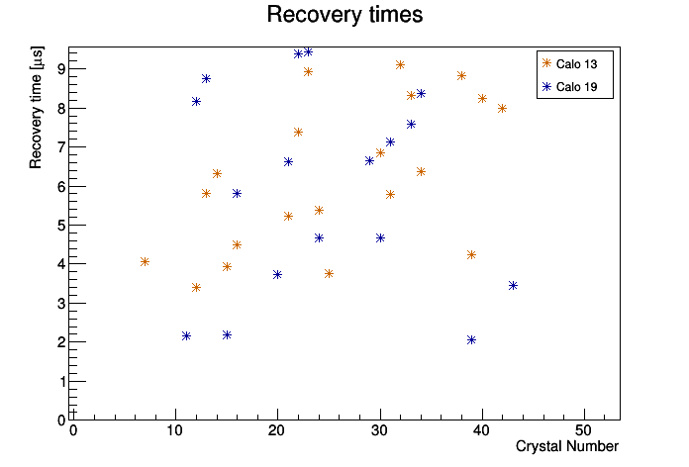
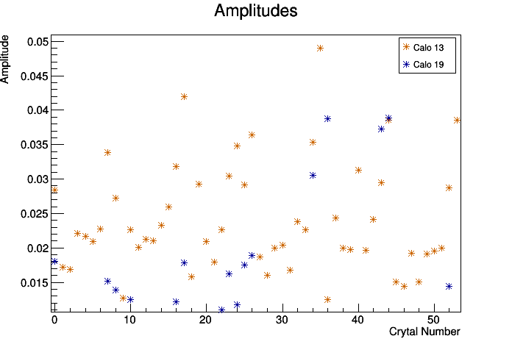
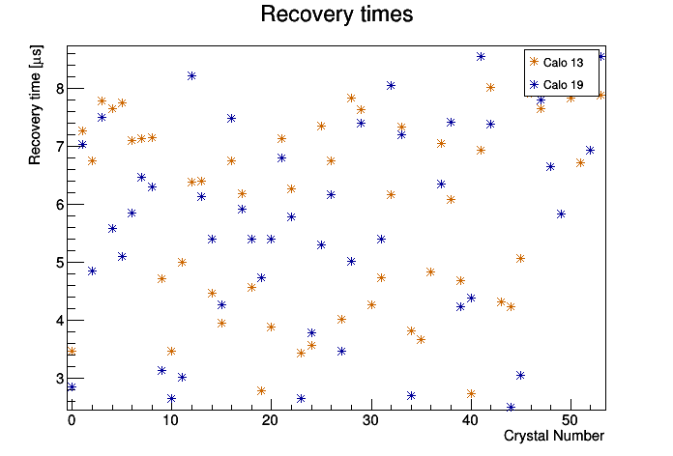
Scatter plots: E/p results and laser results
E/p ratio:
Laser:

Slide 12
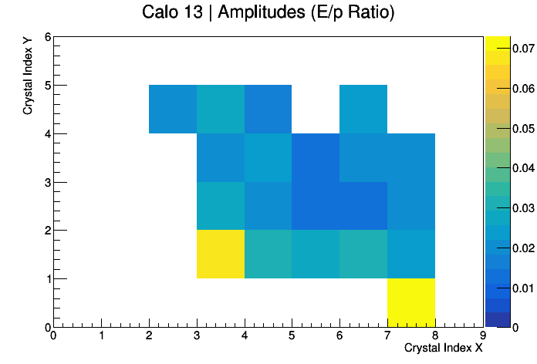

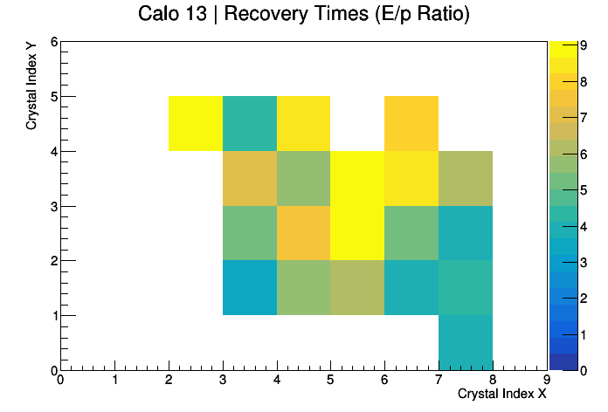

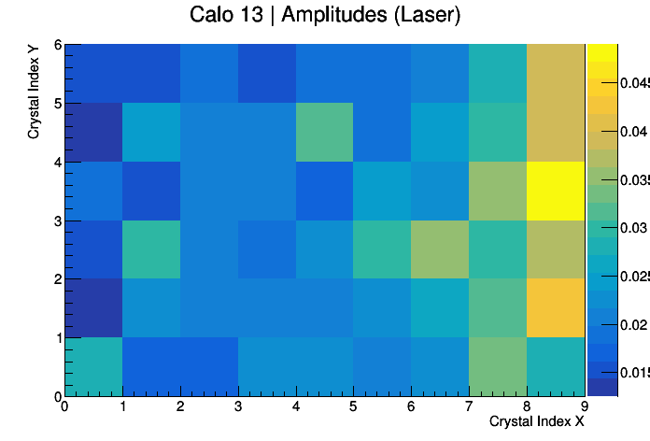

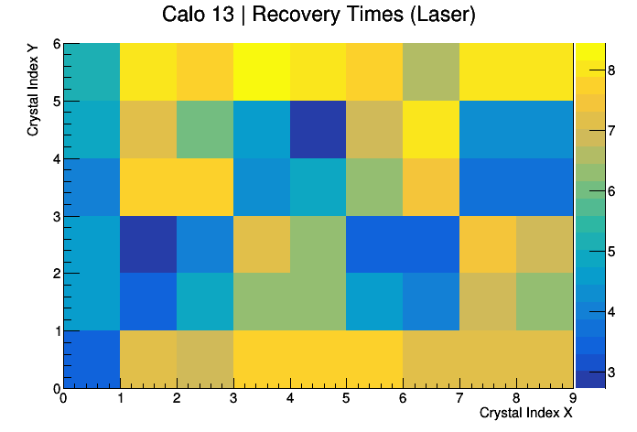

2D plots: E/p results and laser results
E/p ratio:
Laser:

Slide 13
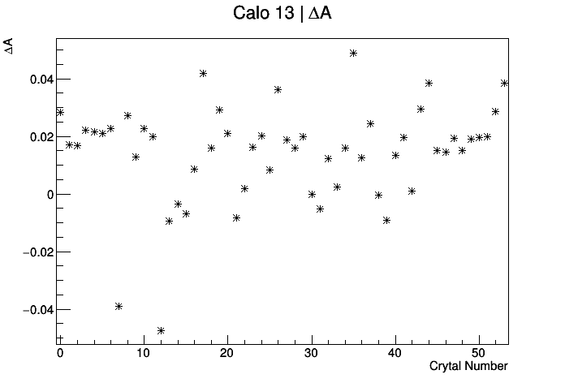
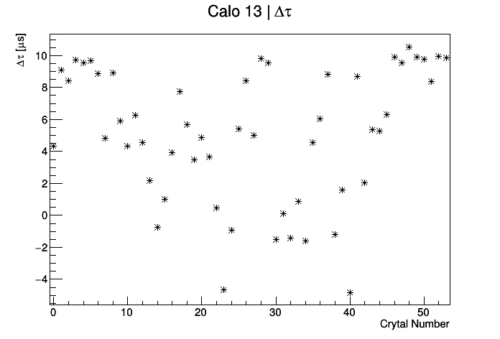
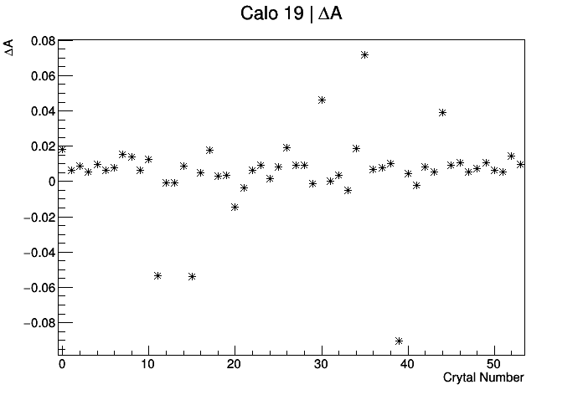
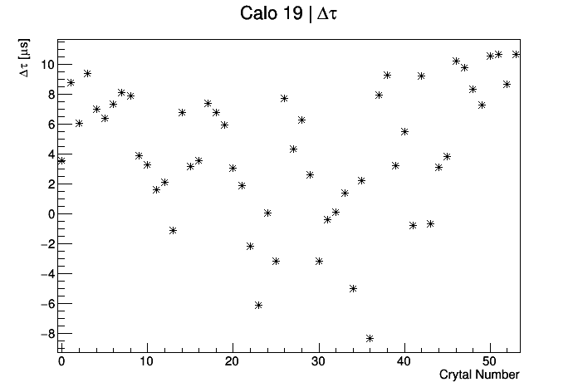
Differences between laser and E/p results
Mean difference = 0.0142067
Mean difference = 4.18167 us
Mean difference = 0.00529655
Mean difference = 5.11914 us

Slide 14
Summary
I still have a bit of work to do here, but I hope to tie up the loose ends pretty quickly (this week really)
The effect is real, and confirms what the laser reports.
I’m ultimately limited by stats

Slide 15
BACKUP

Slide 16
Method
Make 2D plots of E/p vs t
Fit y-projections of each x-bin with gaussians, and plot the gaussian mean and it’s error (a better alternative to a profile)
Separate tracks according to breaker board
Require 1 crystal hit per track
Fit resulting distribution to extract the recovery time and gain sag amplitude with function:
Repeat process on a crystal by crystal basis
Compare with laser results

Slide 17
Details!
Using Europa Ntuples, available in:
gm2/data/g2be/Production/Trees/v9_17_01/60hr/
Tracker group’s quality flag: “Track quality = true”. See James Mott (2019):
https://gm2-docdb.fnal.gov/cgi-bin/private/ShowDocument?docid=16444
Cluster track time difference between -8 and +3 ns for station 12, and between -9 and +1 ns for station 18
Radial difference, dR < 30 mm
Positron selection:
-0.3 < Log(E/p) < 0.2;
Region of highest flux:
1.2< E [GeV] < 2.4

Slide 18
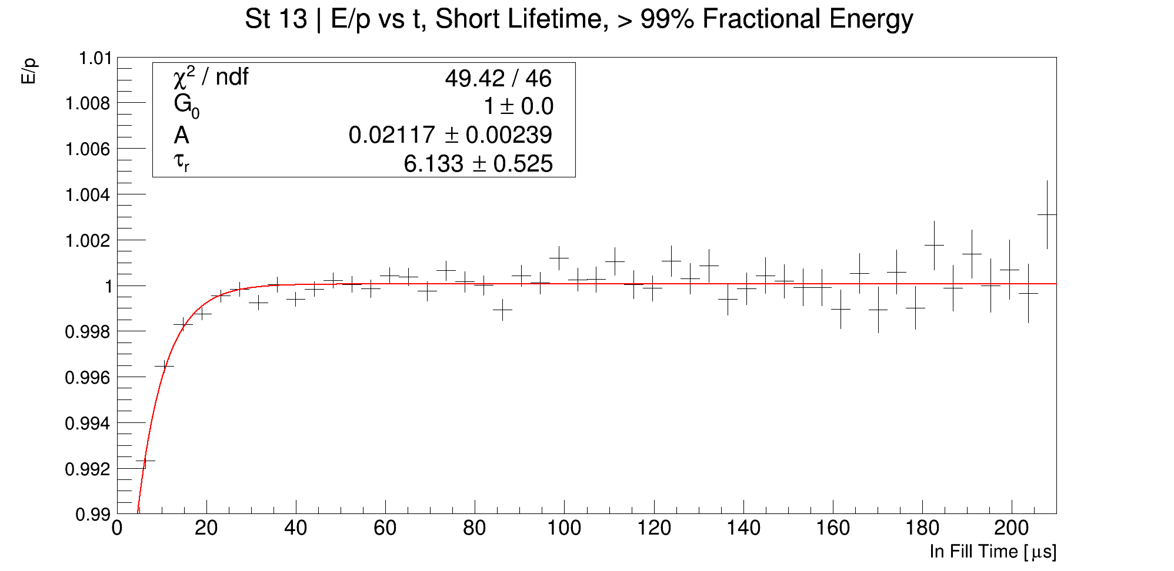
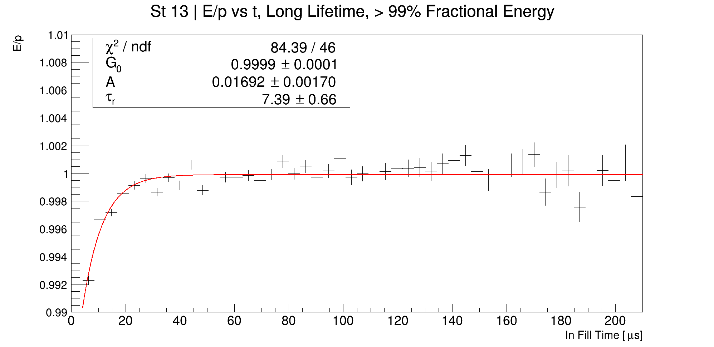
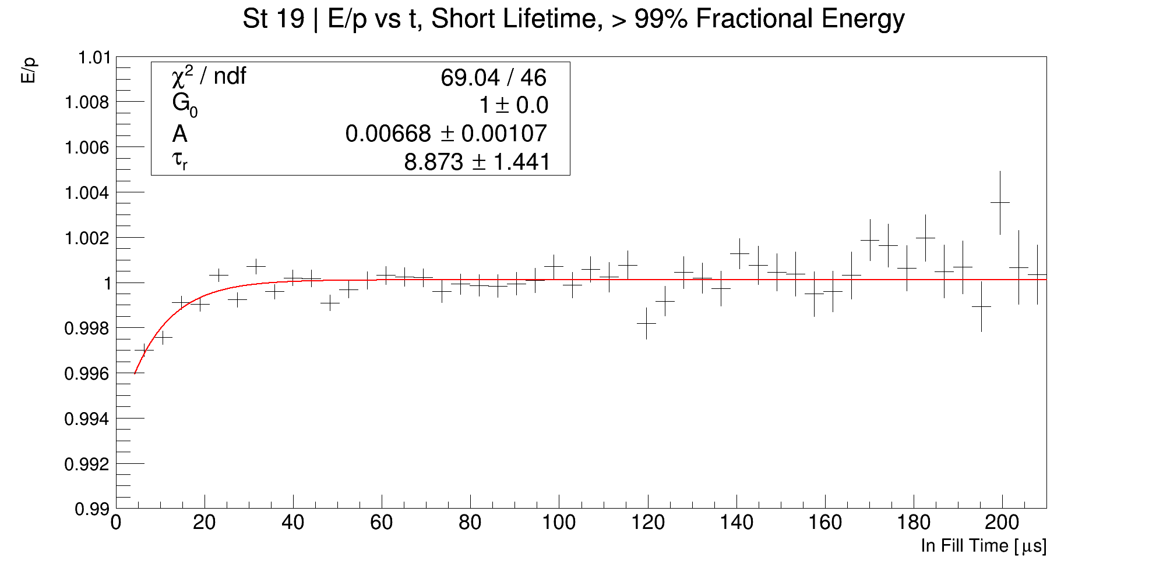
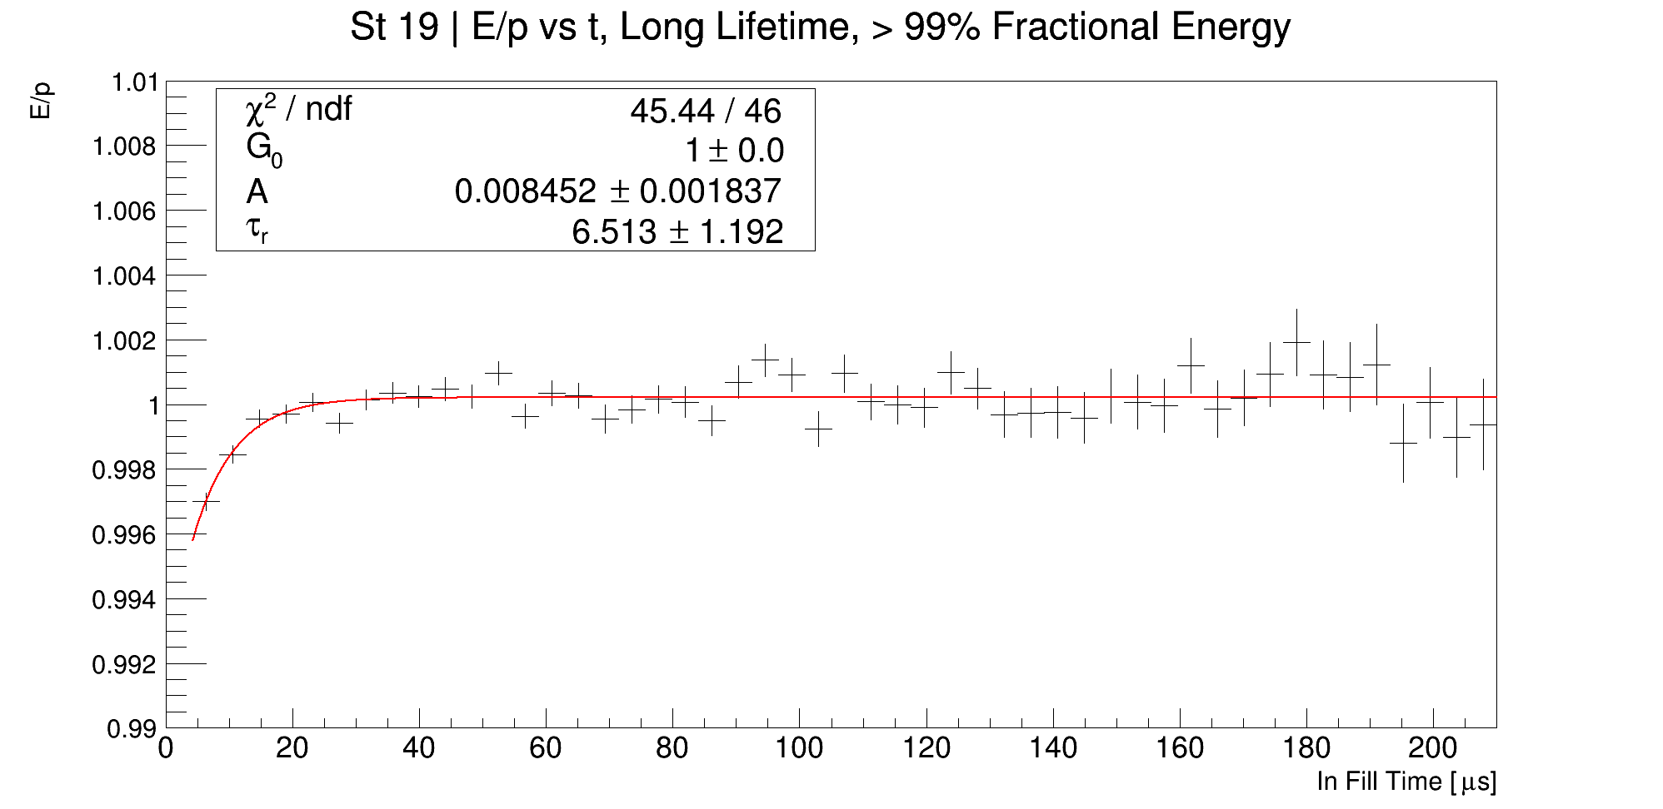
Recovery times per station, > 99% fractional energy

Slide 19
Time difference (dt), radial difference (dR), log(E/p)
Credit: Gavin Hesketh

Slide 20
Preamble
I am using the tau and amplitude values contained in the fcl file:
“gm2Dev_v9_20_00/srcs/gm2calo/fcl/inFillGainParams_withlognstdp.fcl”
If anyone wants my values, I have them in both csv and ROOT format
Question: why no uncertainties in the fcl file?
*Detail on cuts ect in backup

Slide 21
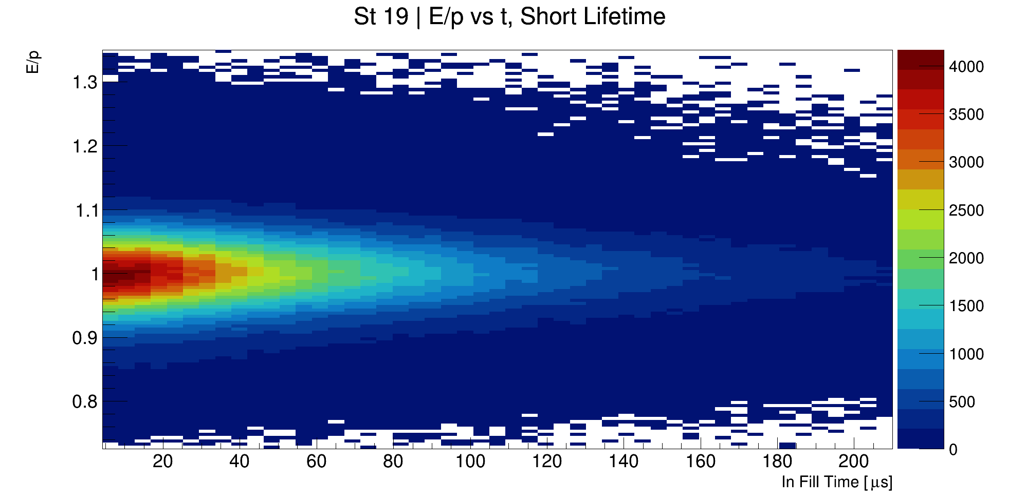
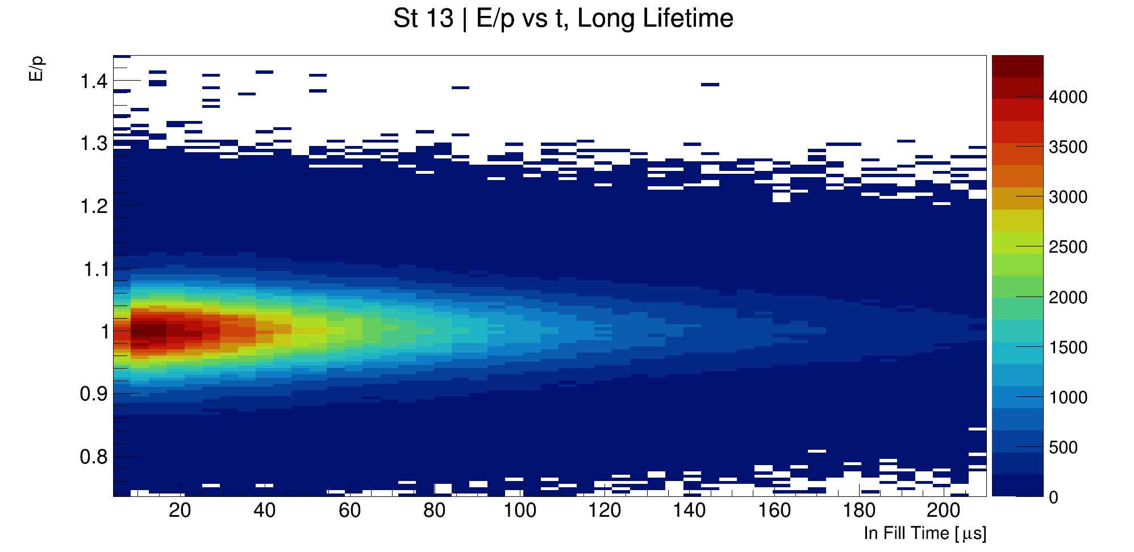
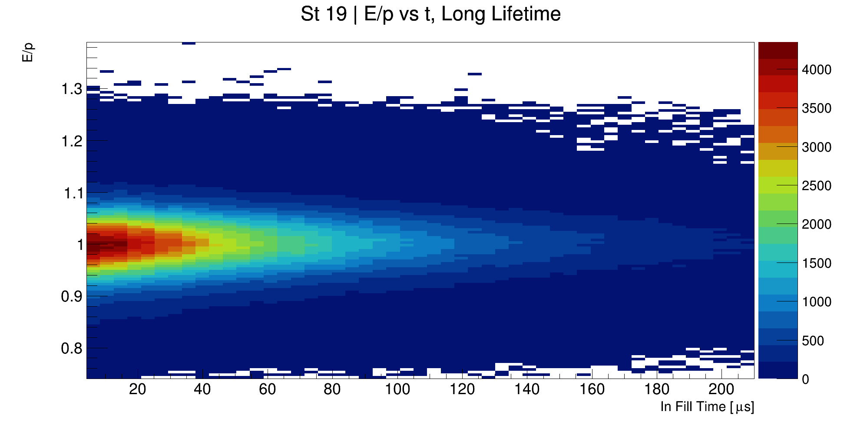
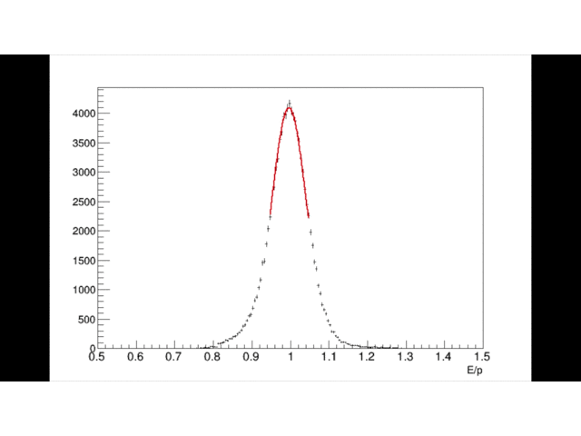
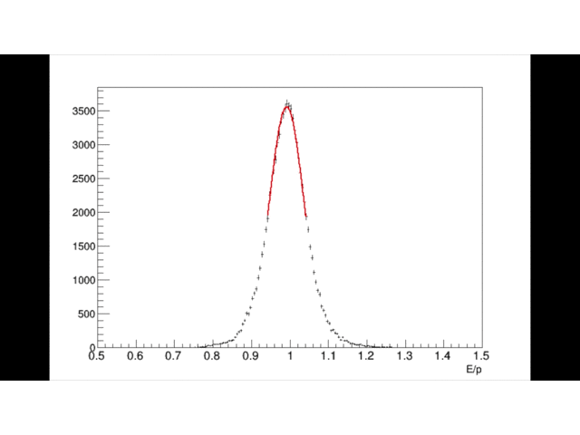
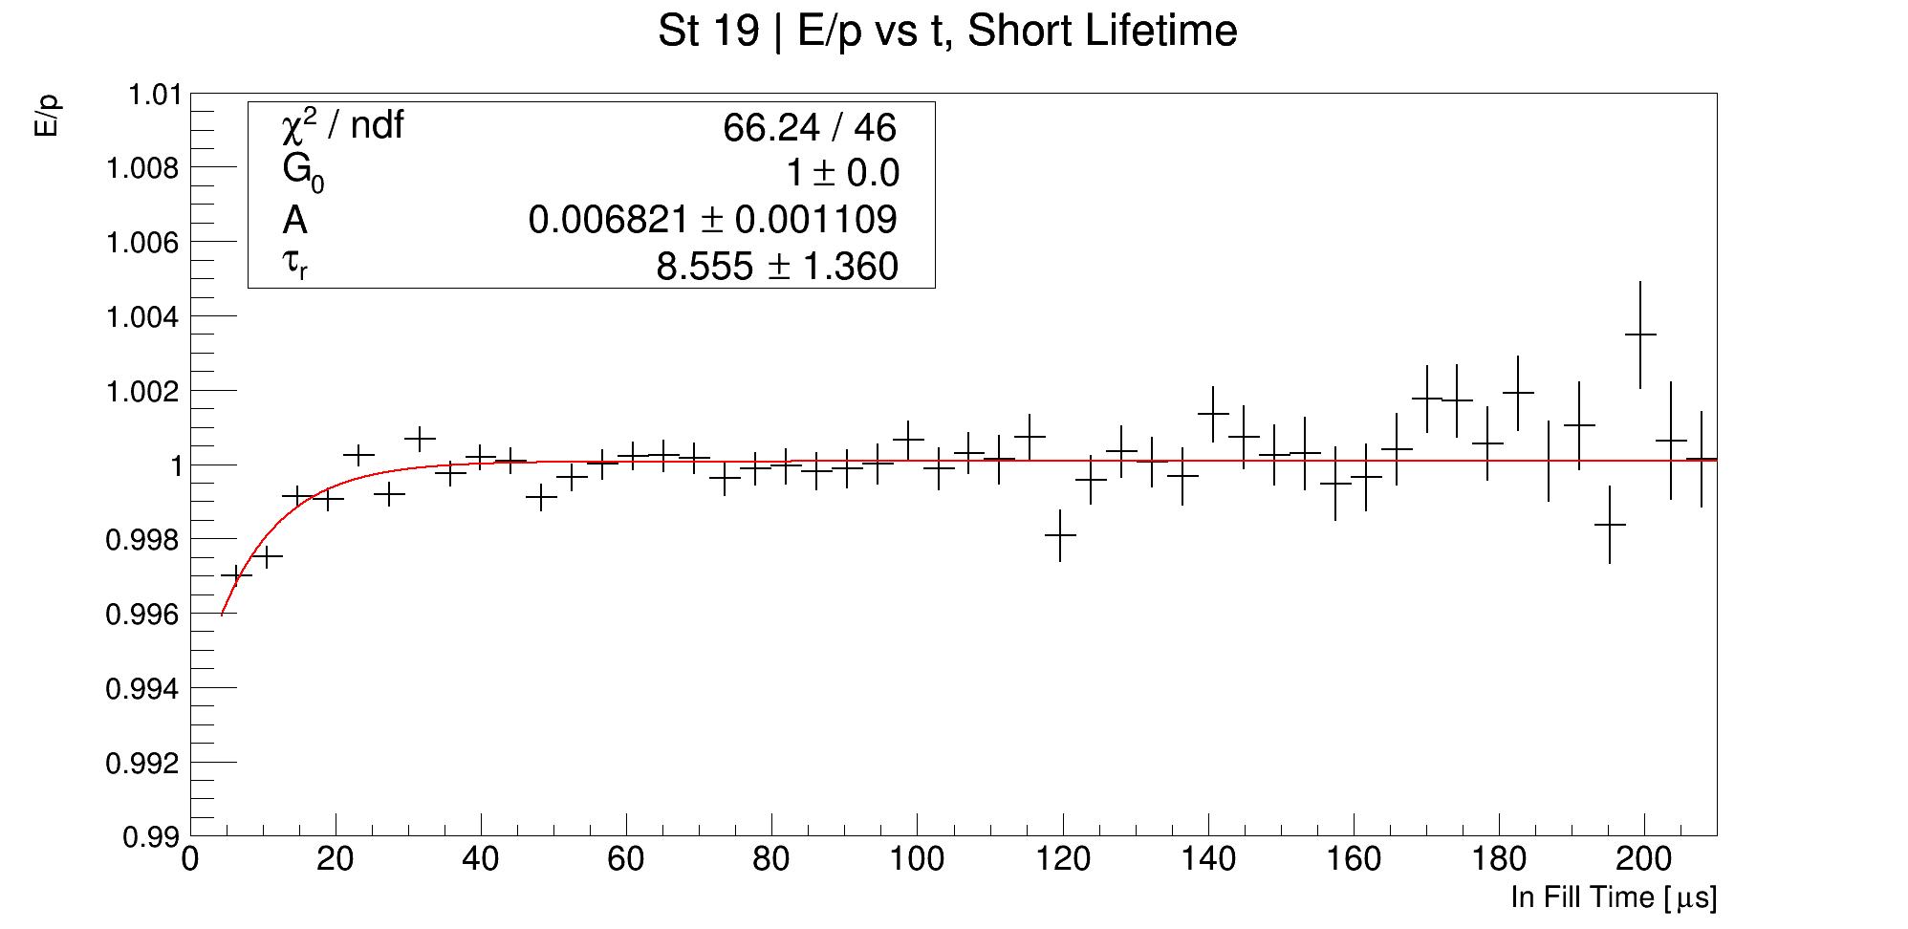
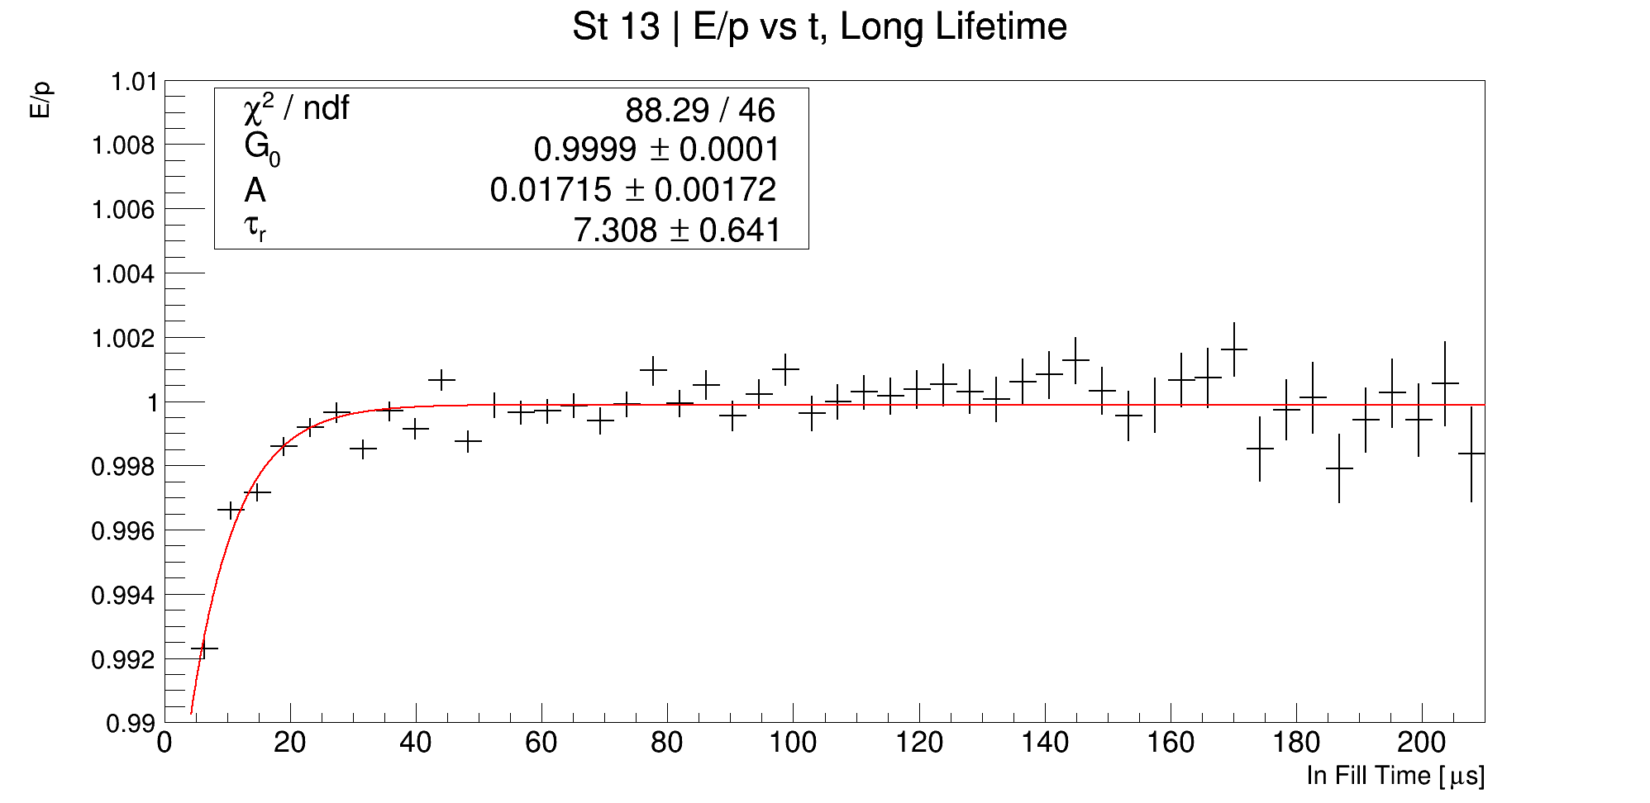
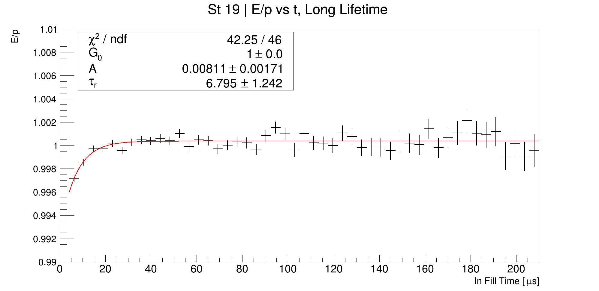
E/p vs time, separated by breaker board

